Slide 1
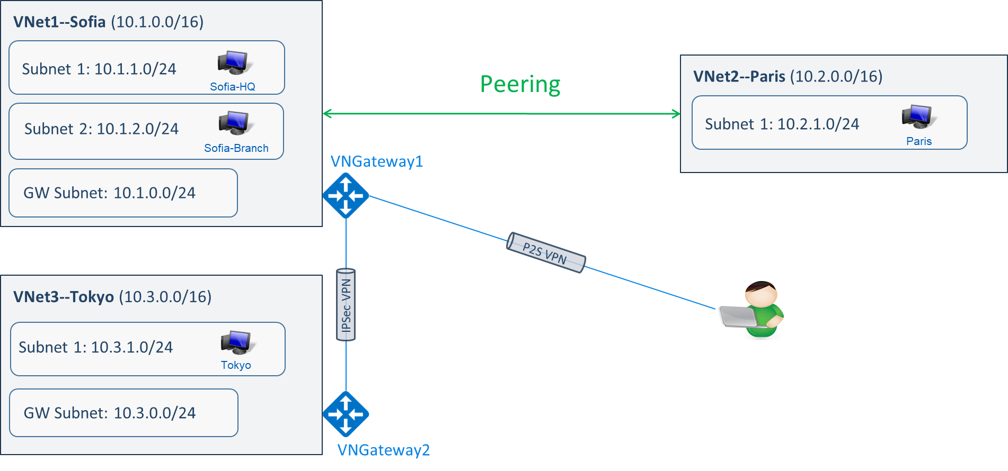
Cloud networking with Microsoft Azure
Lecture 9
SoftUni Team
Technical Trainers
Software University
http://softuni.bg

Slide 2
Table of Contents
Introduction to Azure networking
Inter-site connectivity options
DNS hosting in Azure
Virtual network traffic routing
Demonstration

Slide 3
Introduction to Azure networking

Slide 4
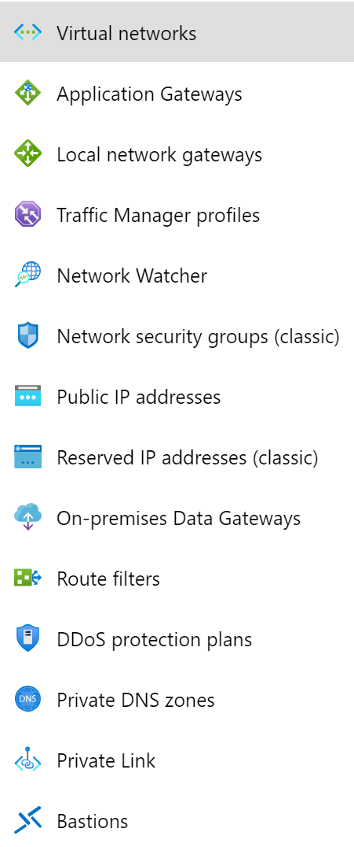
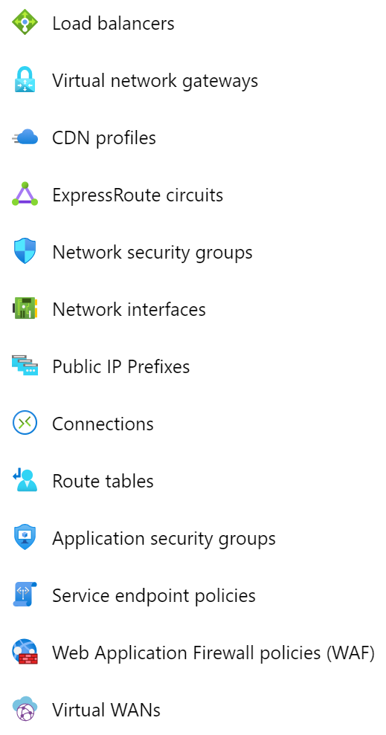
Azure networking components

Slide 5
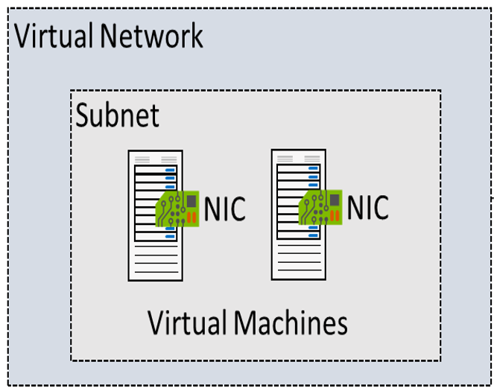
Virtual networks in Azure (VNets)
VNets are logical representation of your own network, they let you create your own private space in Azure
The traffic between virtual machines in a VNet uses the Microsoft backbone infrastructure

Slide 6
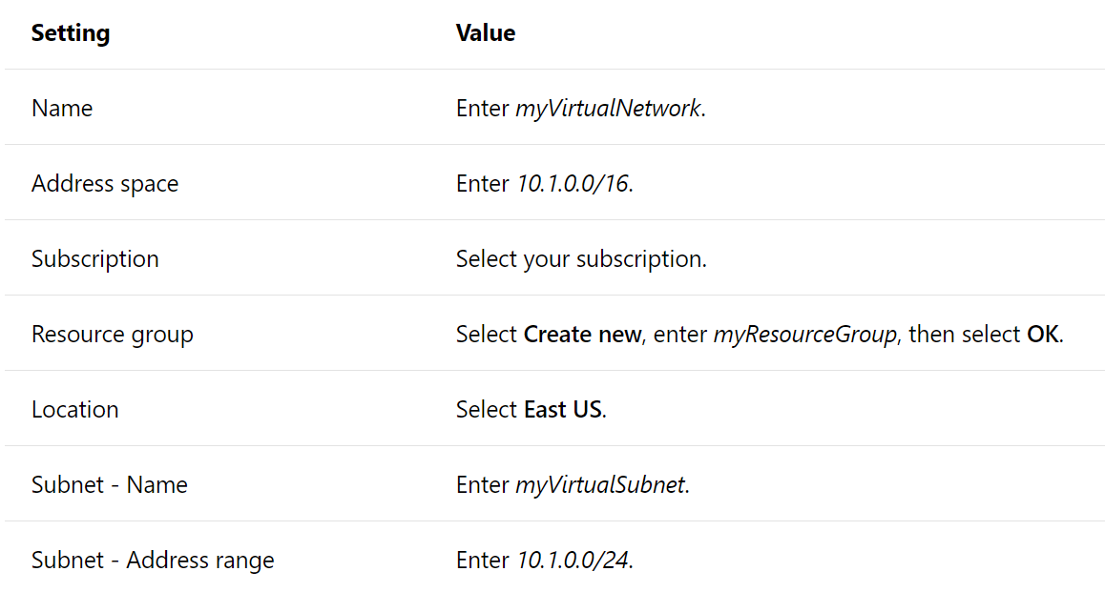
Creating a virtual network

Slide 7
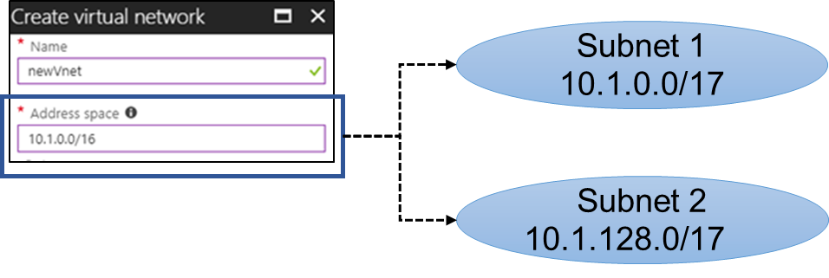
Subnets
A virtual network can be segmented into one or more subnets
Subnets provide logical divisions within your network
Benefits of subnetting a virtual network include security and performance
Each subnet must have a unique address range - cannot overlap with other subnets in the virtual network in the subscription

Slide 8
IP addressing
There are two types of IP addresses you can use in Azure:
Public IP addresses: Used for communication with the Internet, including Azure public-facing services
Private IP addresses: Used for communication within an Azure virtual network (VNet), and your on-premises network (if you use VPN gateway or ExpressRoute)
Remember the private IP address ranges?
For the private addresses, Azure reserves the first four in each subnet address range
Allocation methods (for both public and private IP addresses)
Dynamic
Static
Even the selected allocation method is “static”, you should avoid assigning IP addresses within the virtual machine's operating system

Slide 9
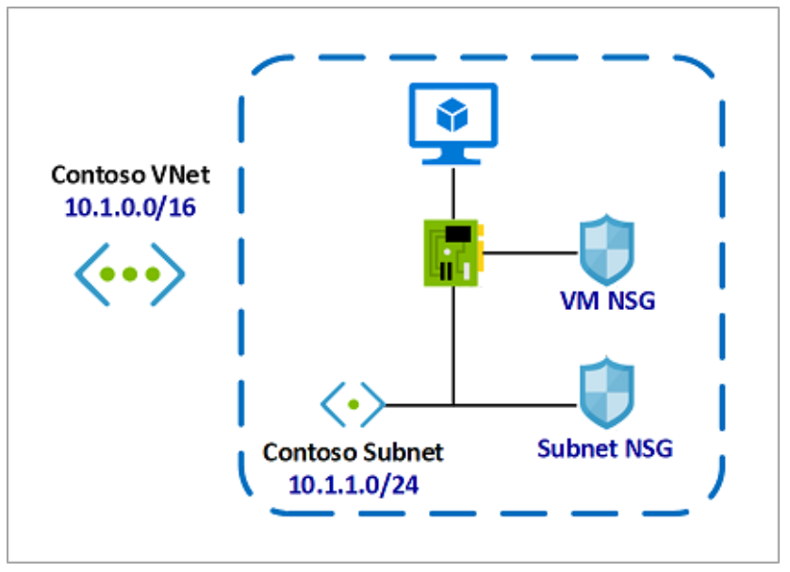
Network Security Groups (NSG)
You can limit network traffic to resources in a virtual network
An NSG contains a list of security rules that allow or deny inbound or outbound network traffic
An NSG can be associated to a subnet or a network interface
Similar to Access Control Lists discussed before

Slide 10
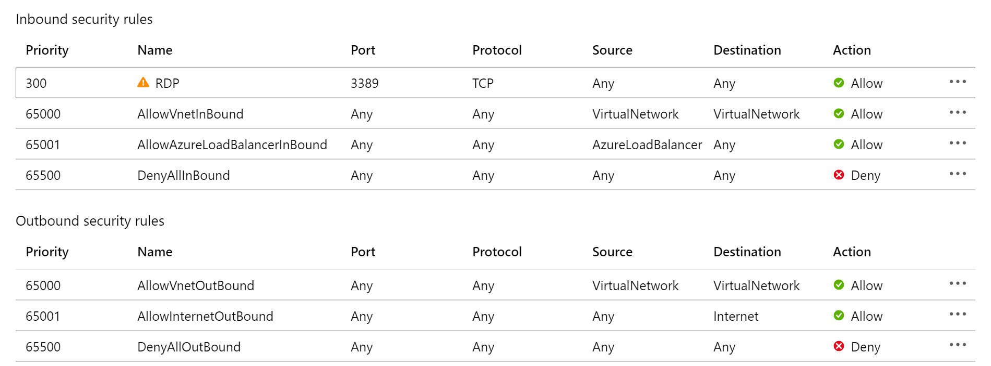
NSG rules
Security groups have default inbound and outbound rules and you can add custom ones
Rules are processed in priority order. The lower the number, the higher the priority
To match a traffic, specify port, protocol, source and destination
After the traffic is matched, an action is applied (allow or deny) and then processing stops

Slide 11
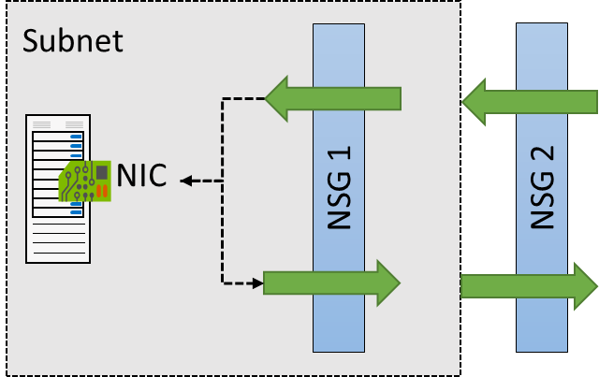
NSG effective rules
NSGs are evaluated independently for the subnet and NIC
Use the Effective Rules link if you are not sure which security rules are being applied

Slide 12
Inter-site connectivity options

Slide 13
Virtual network peering
VNet peering connects two Azure virtual networks
Peered networks use the Azure backbone for privacy and isolation
Easy to setup, seamless data transfer and great performance
VNet1--Sofia (10.1.0.0/16)
Peering
VNet2--Paris (10.2.0.0/16)
Subnet1: 10.1.1.0/24
Subnet1: 10.2.1.0/24
Subnet2: 10.1.2.0/24

Slide 14
VPN gateway
Used to send encrypted traffic between Azure and on-premise
Can also create tunnels between Azure virtual networks
Can accept multiple connections
Each VNet can have only one VPN gateway
Special VNet subnet is required before creating the VPN gateway
Different connection topology diagrams are supported (next slides)

Slide 15
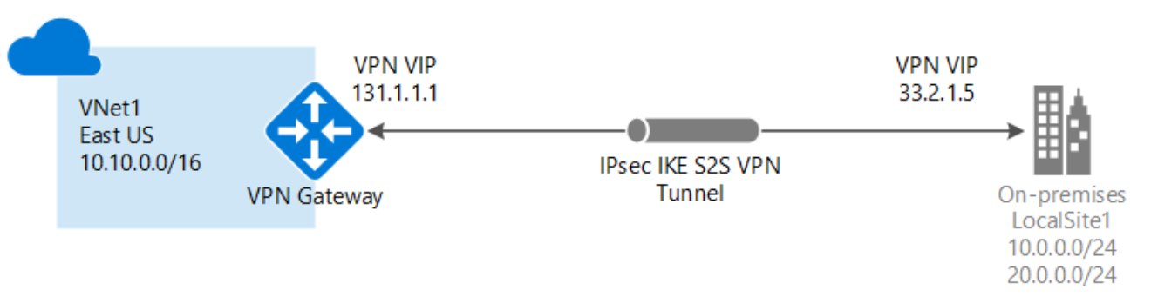
Site-to-Site (IPsec/IKE VPN tunnel)

Slide 16
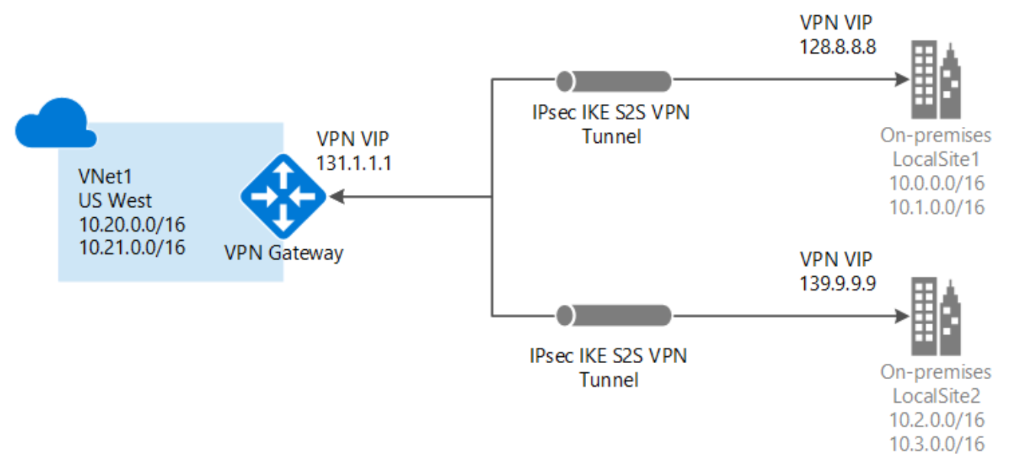
Multi-Site (IPsec/IKE VPN tunnel)

Slide 17
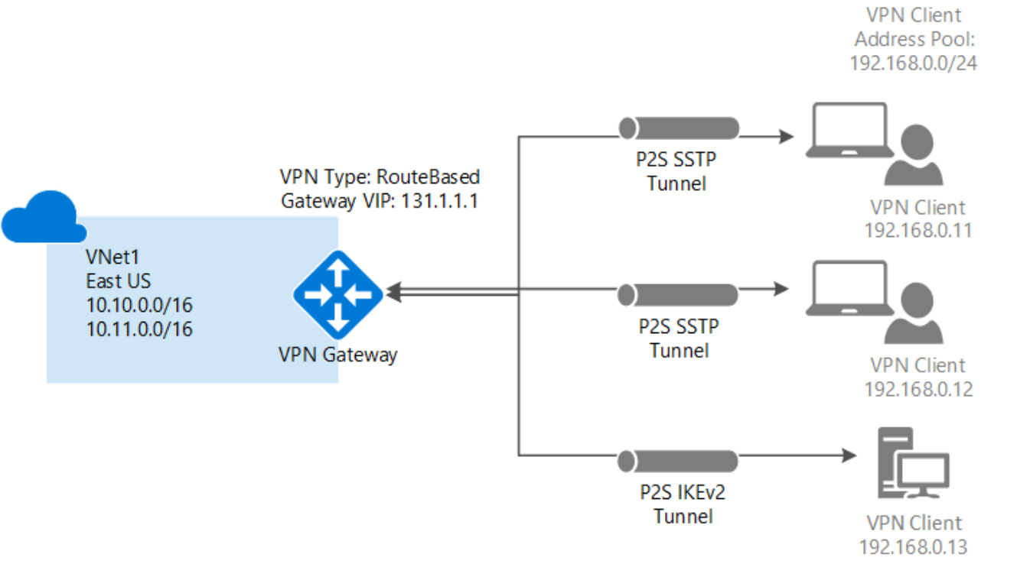
Point-to-Site (VPN over IKEv2 or SSTP)

Slide 18
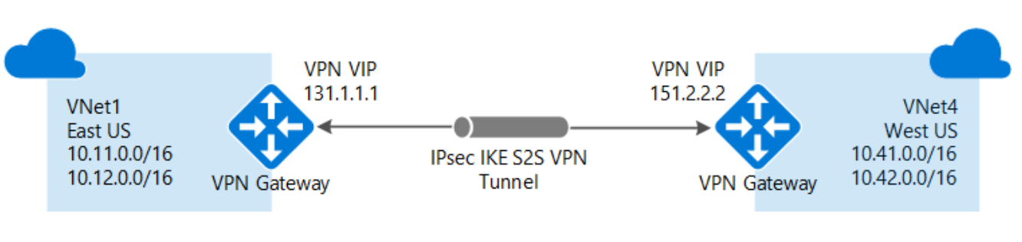
VNet-to-VNet connections (IPsec/IKE VPN tunnel)

Slide 19
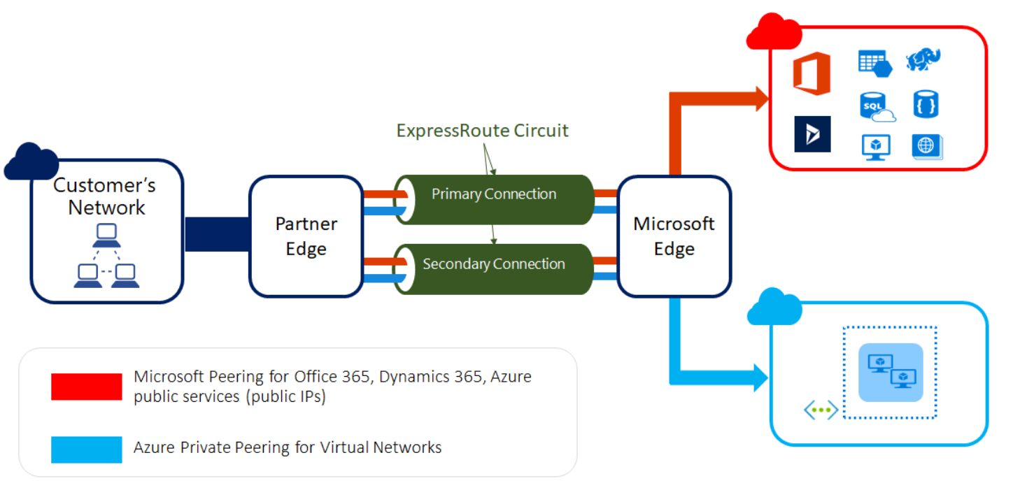
ExpressRoute
Let's you extend your on-premises networks into the Microsoft cloud over a private connection
Facilitated by a connectivity provider

Slide 20
DNS hosting in Azure

Slide 21
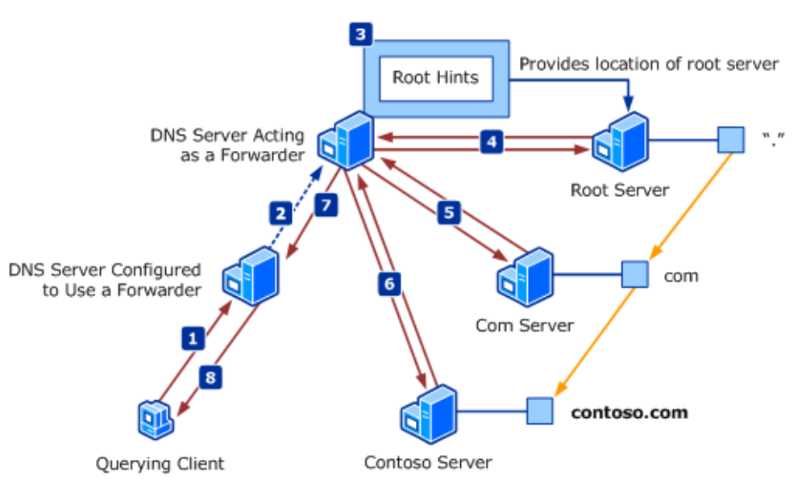
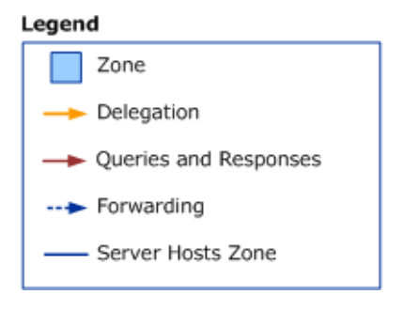
Remembering how DNS works

Slide 22
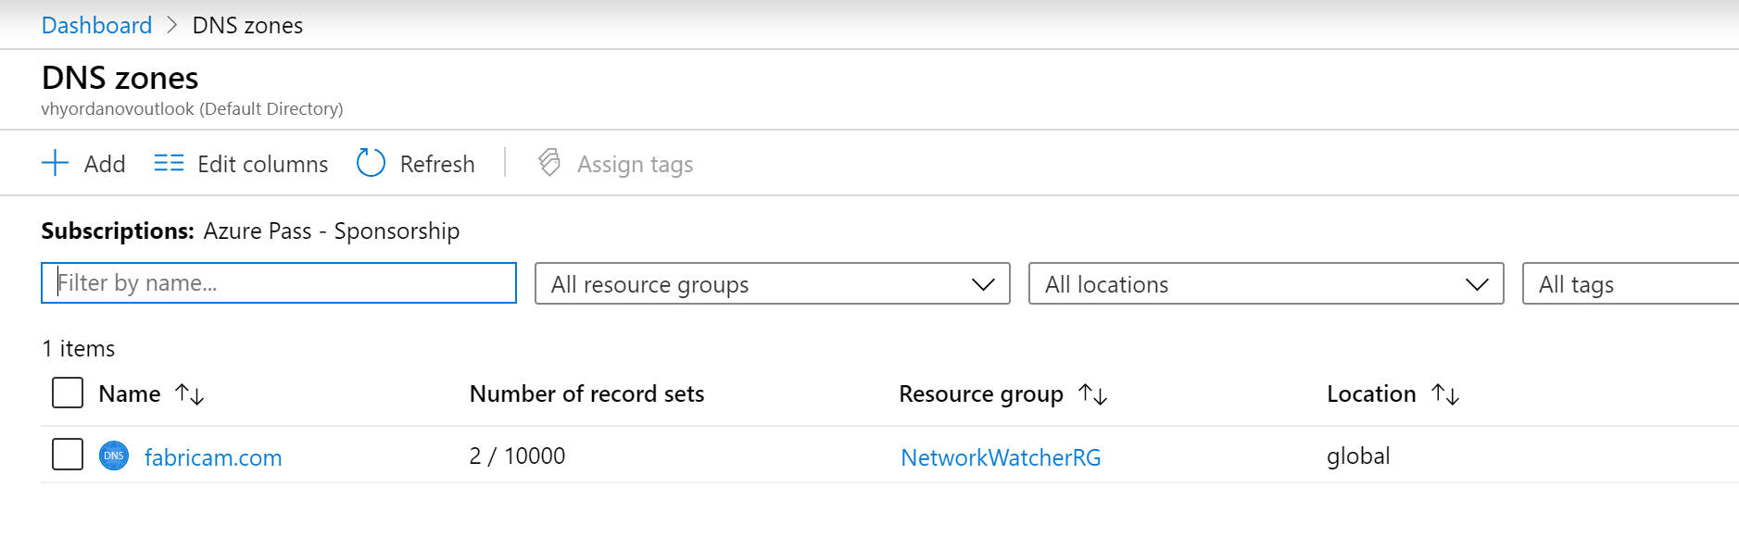
Azure DNS zones
Azure offers a DNS service where you can host your DNS zones
You do not have to own the domain to create a DNS zone with that domain name in Azure
But…if you want the records in your domain to be resolved by everyone in Internet, then:
You must own the domain
You must change the name servers in your domain register to point to your Azure DNS zone

Slide 23
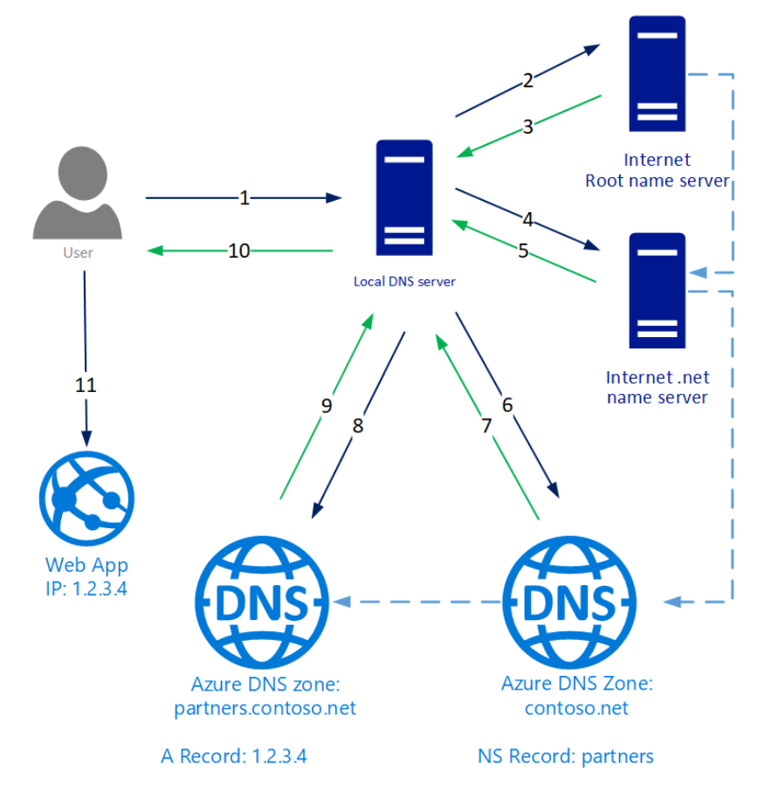
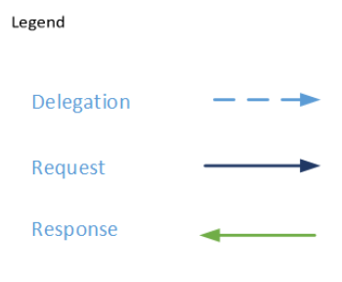
DNS delegation
For DNS queries to a domain to reach Azure DNS, the domain must be delegated to Azure DNS from the parent (point the name servers to the “child”, hosting the zone)

Slide 24
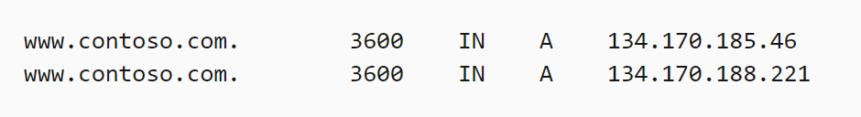
DNS record sets
Inside a DNS zone, you create DNS records
Some examples of common DNS records:
In Azure, DNS records are created in record sets (inside a zone)
A record set is collection of DNS records which have the same name and are of the same type:
(although most record sets contain a single record)
A: a name which points to an IPv4 address | SRV: used for service discovery
CNAME (alias): a name which points to another name | NS: shows which are the name servers for the zone
MX: shows who is the mail server for that domain | SOA: contains administrative information about the zone

Slide 25
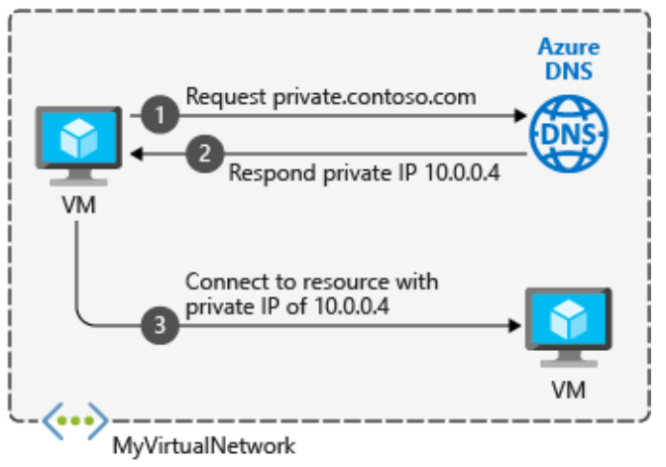
Private DNS zones
Private DNS zones provide name resolution in virtual networks without the need to add a custom DNS solution
Not accessible over the Internet
Capabilities and benefits:
All common DNS records types are supported
Hostname resolution between virtual networks
Automatic hostname record management
Available in all Azure regions
When you create a Private DNS zone, you have to link it with one or more virtual networks

Slide 26
Virtual network traffic routing

Slide 27
System routes
System routes direct network traffic between virtual machines, on-premises networks and the Internet:
Traffic between VMs in the same subnet
Between VMs in different subnets in the same virtual network
Data flow from VMs to the Internet
Communication between VMs using a VNet-to-VNet Peering
Communication between VMs using a VNet-to-VNet VPN
Site-to-Site and ExpressRoute communication through the VPN gateway

Slide 28
User-defined routes (UDR)
You can create custom (user-defined) routes in Azure to override Azure’s default system routes, or to add additional routes to a subnet's route table
User-defined routes control network traffic by defining routes that specify the next hop of the traffic flow
A route table contains a set of rules, called routes, that specifies how packets should be routed in a virtual network
The next hop can be:
Virtual appliance
Virtual Network Gateway
Virtual Network
Internet
None

Slide 29
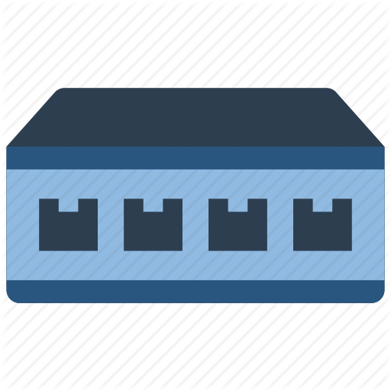

Routing example
Before the UDR, system routes connects VMs from each subnet directly
After a UDR is created, the routing table for Subnet 1 is updated so the traffic goes via the Virtual appliance in Subnet 2
VNet1:10.1.0.0/16
Subnet 1
10.1.1.0/24
Subnet 3
10.1.3.0/24
Subnet 2
10.1.2.0/24
NVA

Slide 30
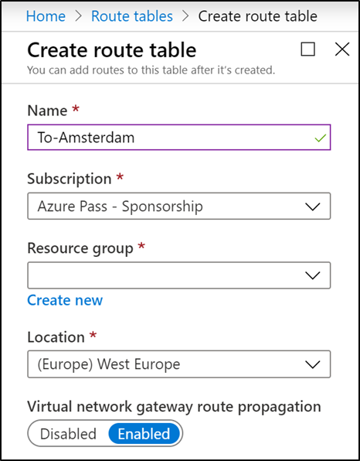
Creating a route table
The first thing for a UDR is to create a route table
Create a name and select subscription, resource group and location
“Virtual network gateway route propagation” should be enabled if you want your on-premises routes to be propagated to the subnet

Slide 31
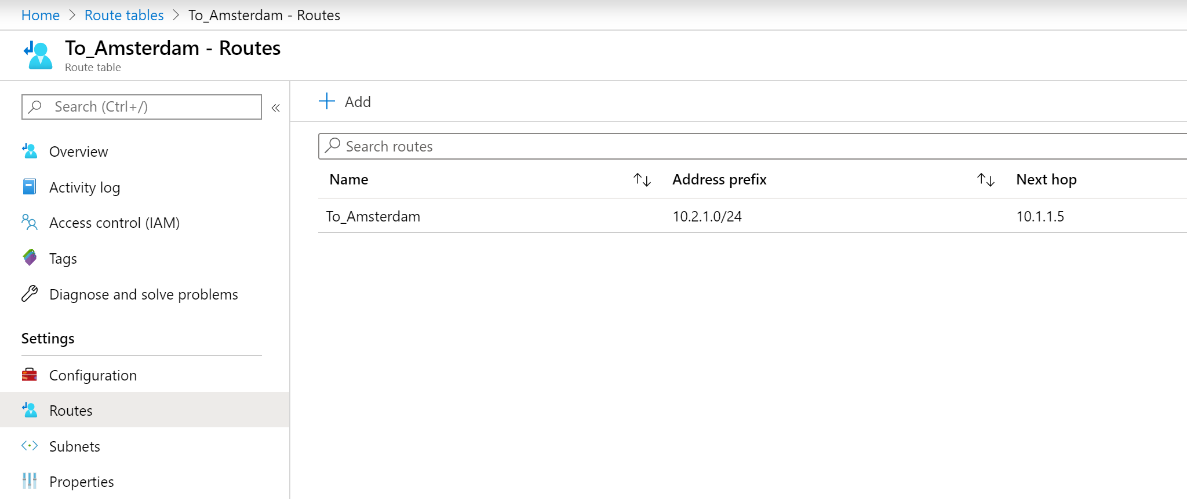
Creating a custom route
The second thing is to create a route in your routing table
The custom route specifies:
Where do you want to route your traffic to? (the “Address prefix” section in CIDR format)
How to go there? (the “Next hop type”)

Slide 32
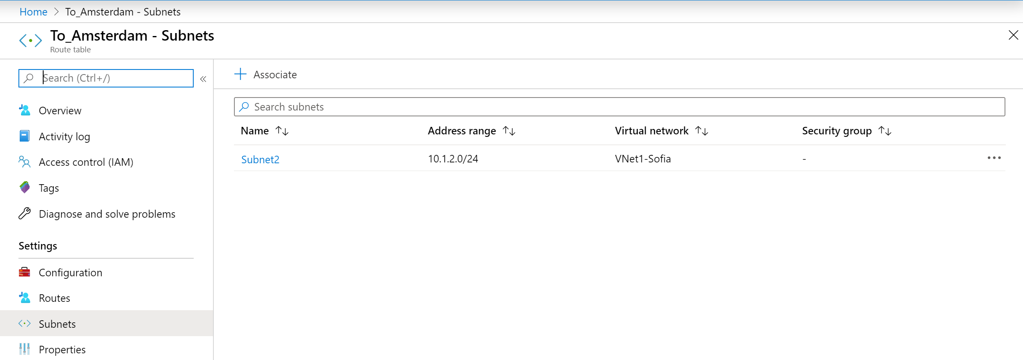
Associate the route table
Finally, associate the route table with a subnet(s)
Each route table can be associated with multiple subnets, but one subnet can be associated with a maximum one route table

Slide 33
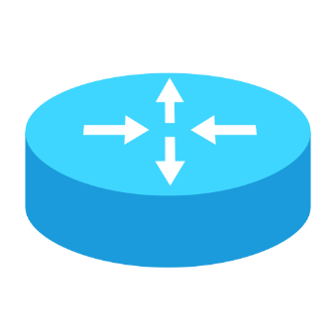
How Azure selects a route
When there are overlapping subnets, Azure uses the rule of the longest match
My routing table:
192.168.0.0/16 via 10.1.1.1
192.168.5.0/24 via 10.15.15.1
0.0.0.0/0 via 10.32.32.1
How do I reach 192.168.5.18?
How do I reach 192.168.12.6?
How do I reach 4.3.2.1?
Answer: via 10.15.15.1
Answer: via 10.1.1.1
Answer: via 10.32.32.1

Slide 34
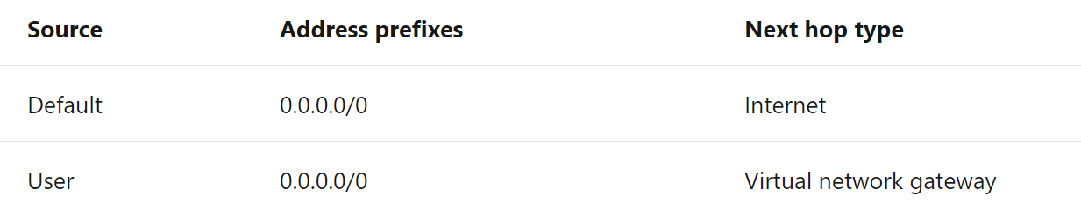
How Azure selects a route (2)
If multiple routes contain the same address prefix, Azure selects the route type based on the following priority:
User-defined route
System route
Example:

Slide 35
Demonstration

Slide 36



Demonstration topology
VNet1--Sofia (10.1.0.0/16)
Subnet 1: 10.1.1.0/24
Peering
VNet2--Paris (10.2.0.0/16)
Sofia-HQ
Subnet 2: 10.1.2.0/24
Subnet 1: 10.2.1.0/24
Sofia-Branch
VNGateway1
Paris
GW Subnet: 10.1.0.0/24
P2S VPN
VNet3--Tokyo (10.3.0.0/16)
IPSec VPN
Subnet 1: 10.3.1.0/24
Tokyo
GW Subnet: 10.3.0.0/24
VNGateway2

Slide 37
Demonstration topology (no animations)
VNet1--Sofia (10.1.0.0/16)
Subnet 1: 10.1.1.0/24
Peering
VNet2--Paris (10.2.0.0/16)
Sofia-HQ
Subnet 2: 10.1.2.0/24
Subnet 1: 10.2.1.0/24
Sofia-Branch
VNGateway1
Paris
GW Subnet: 10.1.0.0/24
P2S VPN
VNet3--Tokyo (10.3.0.0/16)
IPSec VPN
Subnet 1: 10.3.1.0/24
Tokyo
GW Subnet: 10.3.0.0/24
VNGateway2

Slide 38
Demonstration details
Create the VNets, subnets and gateways and attach the respective VMs
Create a private DNS zone and link it with all VNets
Create a peering between VNet1--Sofia and VNet2--Paris
Create NSG for VNet2-Paris to deny incoming ICMP (ping). After the test, update it with “allow” statement for incoming ICMP with higher priority
Create the VNet-to-VNet VPN between VNet1--Sofia and VNet3--Tokyo
Allow VNGateway1 to make the connection between VNet2--Paris and VNet3--Tokyo
Create a point-to-site VPN from a local machine to VNet1--Sofia
Change the default routing path between Sofia-Branch and Paris. Now all the traffic should go via Sofia-HQ

Slide 39

Summary
Introduction to Azure networking
Inter-site connectivity options
DNS hosting in Azure
Virtual network traffic routing
Demonstration
…
…
…

Slide 41

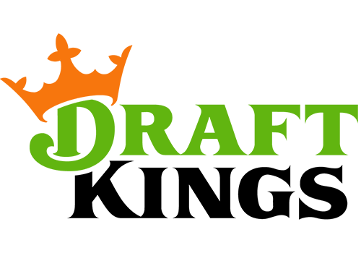
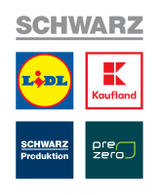
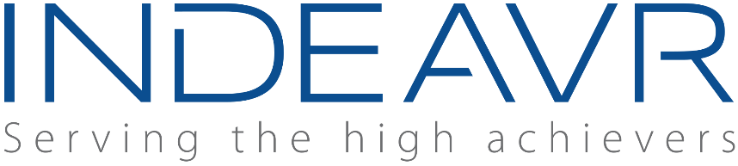



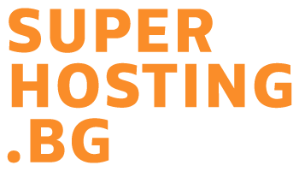


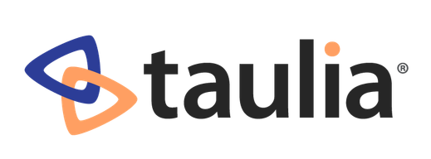

SoftUni Diamond Partners

Slide 42
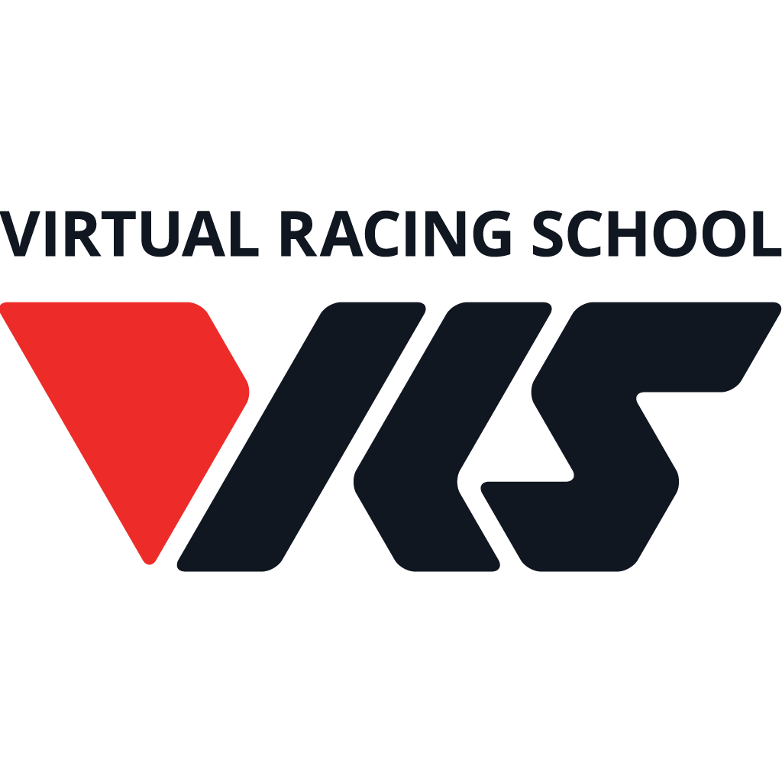

Educational Partners

Slide 43
Trainings @ Software University (SoftUni)
Software University – High-Quality Education, Profession and Job for Software Developers
softuni.bg, about.softuni.bg
Software University Foundation
softuni.foundation
Software University @ Facebook
facebook.com/SoftwareUniversity
Software University Forums
forum.softuni.bg
Notes:
43

